Slide 1
Hackthon 3
Competition: Sentiment Analysis Hackathon
Predict the Sentiment
Guided by:
Amitanshu Gupta
By: Team Pandas
1.Rahul Kirpane
2.Barbar mohd fakhruddin
3.Garima Rawat
4.Priyanka Pagare
5.Naureen Khan

Slide 2
Problem Statement
The evaluated tweets about multiple brands are given in the dataset. The data consists of the tweets expressed (positive, negative, neutral or no emotion towards a product/brand) by the evaluators(random audience) and is labelled accordingly.
To gain valuable insight from the desired audience by identifying the sentiments about the product/brand.
Building a strong classification algorithm to classify new tweets.
Notes:
Can we include some examples here?

Slide 3
Motivation
In the past decade, new forms of communication, such as microblogging and text messaging have emerged and become very frequent. While there is no limit to the range of information conveyed by tweets and texts, often these short messages are used to share opinions and sentiments that people have about what is going on in the world around them.
Tweets and texts are short: a sentence or a headline rather than a document. The language used is very informal, with creative spelling and punctuation, misspellings, slang, new words, URLs, and genre-specific terminology and abbreviations, such as, RT for "re-tweet" and # hashtags, which are a type of tagging for Twitter messages.
Another aspect of social media data such as Twitter messages is that it includes rich structured information about the individuals involved in the communication. For example, Twitter maintains information of who follows whom and re-tweets and tags inside of tweets provide discourse information.

Slide 4
Why solve this problem?
Sentiment analysis is the interpretation and classification of emotions (positive, negative and neutral) within text data using text analysis techniques and therefore allows businesses to identify customer sentiment toward products, brands or services in online conversations and feedback.
Stakeholders : CEO, CFO, Marketing, Sales, Researchers, social media, analytics researchers, NLP developers, industry managers and practitioners using social media sentiments as input for decision-making.

Slide 5
Data
Dataset Description
This dataset contains around 7k tweet text with the sentiment label.
The file train.csv has 3 columns
tweet_id - Unique id for tweets. tweet - Tweet about the brand/product sentiment -
0: Negative, 1: Neutral, 2: Positive, 3: Can't Tell

Slide 6
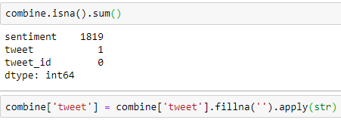
Exploratory Data Analysis
Finding & Handling Missing values in the Data
Code Snippet:

Slide 7

Statistical Description for the Numerical Features

Slide 8
Analysis of Target Feature:
S. No. | Sentiment | Tweet
1 | 0 | 456
2 | 1 | 4310
3 | 2 | 2382
4 | 3 | 125

Slide 9
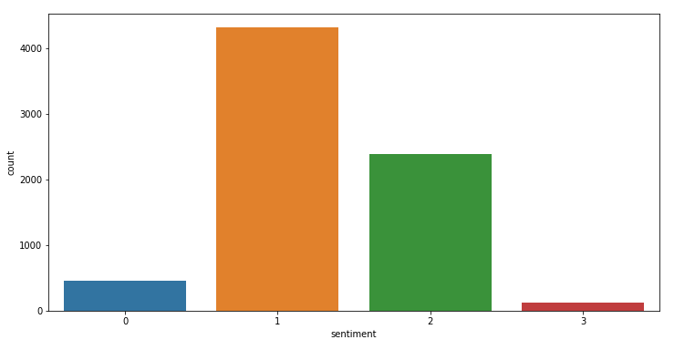
CountPlot for Sentiment Feature:

Slide 10
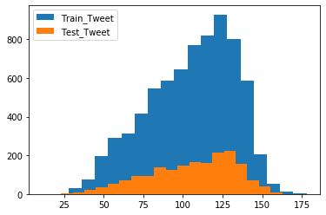
Distribution of length of tweets in train and test dataset

Slide 11
Pipeline for Cleaning & Preprocessing
Removing Twitter Handles (@user)
Removing Punctuations, Numbers, and Special Characters
Converting upper case letters to lower case letters
Removing StopWords
Tokenization
Stemming

Slide 12
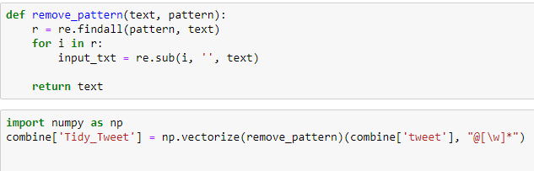
Code Snippet for Cleaning & Preprocessing
Removing Twitter Handles (@user)

Slide 13
Code Snippet for Cleaning & Preprocessing(Contd..)
Removing Punctuations, Numbers, and Special Characters
Removing Short Words

Slide 14
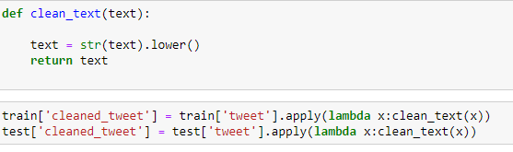
Code Snippet for Cleaning & Preprocessing(Contd..)
Converting upper case letters to lower case letters

Slide 15


Code Snippet for Cleaning & Preprocessing(Contd..)
Tokenization
Stemming

Slide 16
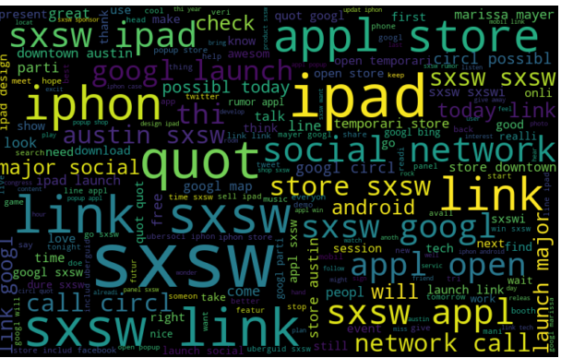
Story Generation & Visualization from Tweets
Most Frequent words used in the tweets using world cloud

Slide 17
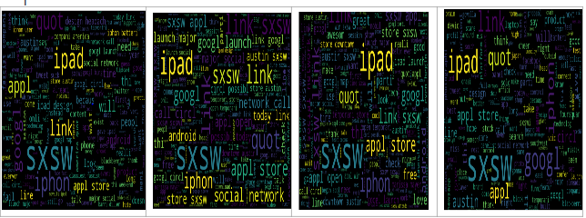
Story Generation & Visualization from Tweets(Contd.)
Most frequent words for each sentiment(0,1,2,3)
(b) ( c) (d)

Slide 18
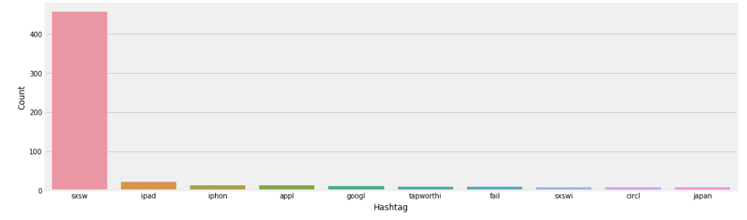
Story Generation & Visualization from Tweets(Contd..)
Plotting top hashtags for tweets sentiment 0

Slide 19
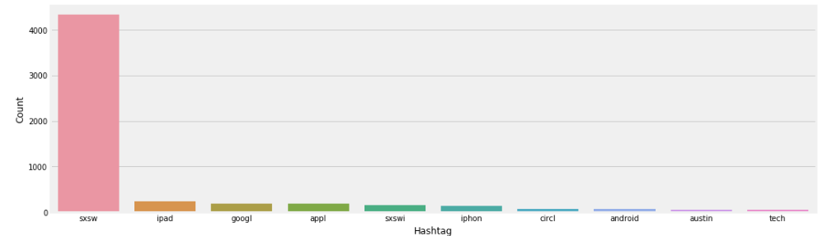
Story Generation & Visualization from Tweets(Contd..)
Plotting top hashtags for tweets sentiment 1

Slide 20
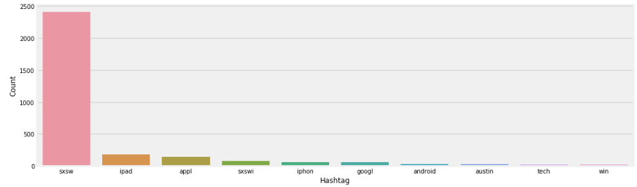
Story Generation & Visualization from Tweets(Contd..)
Plotting top hashtags for tweets sentiment 2

Slide 21
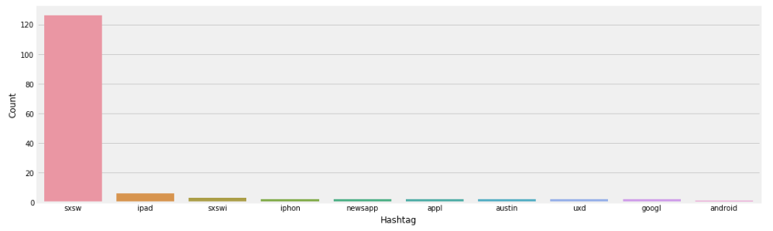
Story Generation & Visualization from Tweets(Contd..)
Plotting top hashtags for tweets sentiment 3

Slide 22

Methods For Extracting Features from Cleaned Tweets
Bag-of-Words Features
Code Snippet:

Slide 23

Methods For Extracting Features from Cleaned Tweet(Contd..)
TF-IDF Features
Code Snippet:

Slide 24
Models and Approaches
done with all the pre-modeling stages required to get the data in the proper form and shape
building models on the datasets with different feature sets prepared in the earlier sections
— Bag-of-Words, TF-IDF, word2vec vectors, and doc2vec vectors
Following algorithms to build models:
1.Logistic Regression
2.Support Vector Machine
3.RandomForest
4. XGBoost

Slide 25
Evaluation Metric
We will be using ‘weighted’ F1-measure as the evaluation metric for this competition. For more information on the F1-metric refer to https://scikit-learn.org/stable/modules/generated/sklearn.metrics.f1_score.html
Sr No. | Model | features | ‘Weighted’ f1 score
1. | Logistic Regression | Bag-of-Words(Count_vectorizier) | 0.66
 |  | TF-IDF | 0.60
 |  | Word2Vec | 0.58
 |  | Doc2Vec | 0.55

Slide 26
Sr No. | Model | features | ‘Weighted’ f1 score
2. | Support Vector Machine | Bag-of-Words | 0.62
 |  | TF-IDF | 0.62
 |  | Word2Vec | 0.57
 |  | Doc2Vec | 0.51

Slide 27
Sr No. | Model | features | ‘Weighted’ f1 score
3. | Random Forest | Bag-of-Words | 0.63
 |  | TF-IDF | 0.64
 |  | Word2Vec | 0.62
 |  | Doc2Vec | 0.54

Slide 28
Sr No. | Model | features | ‘Weighted’ f1 score
4. | XG Boost | Bag-of-Words | 0.64
 |  | TF-IDF | 0.64
 |  | Word2Vec | 0.62
 |  | Doc2Vec | 0.58

Slide 29
Evaluation & Results
F1 Score: -
-Also called F-Score or F-Measure, this is a combination of precision and recall. The score is in a range of 0.0 - 1.0, where 1.0 would be perfect. The F1 Score is very helpful, as it gives us a single metric that rates a system by both precision and recall.
-As such, it is commonly used amongst experts and researchers in the linguistics and natural language processing fields to simply describe the performance of such systems.

Slide 30
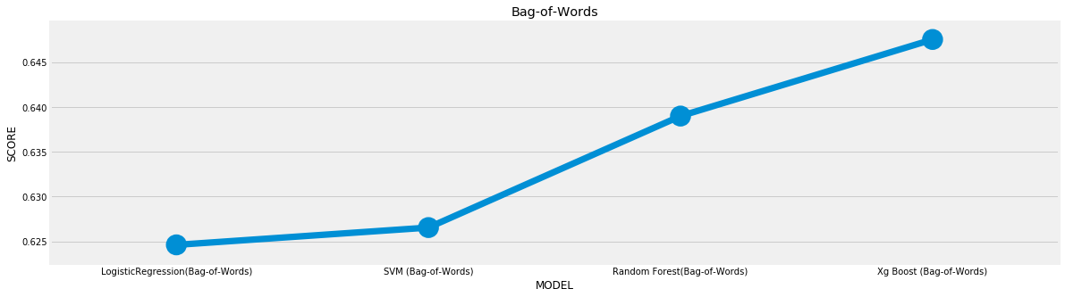
Comparison between Models
Model | LogisticRegression(Bag-of-Words) | SVM (Bag-of-Words) | Random Forest(Bag-of-Words) | Xg Boost (Bag-of-Words)
F1_Score | 0.664628 | 0.626554 | 0.638981 | 0.647515

Slide 31
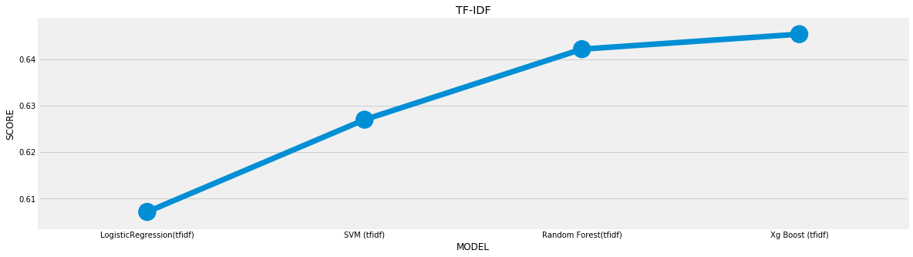
Model | LogisticRegression(tfidf) | SVM (tfidf) | Random Forest(tfidf) | Xg Boost (tfidf)
F1_Score | 0.607057 | 0.626932 | 0.642134 | 0.645368

Slide 32

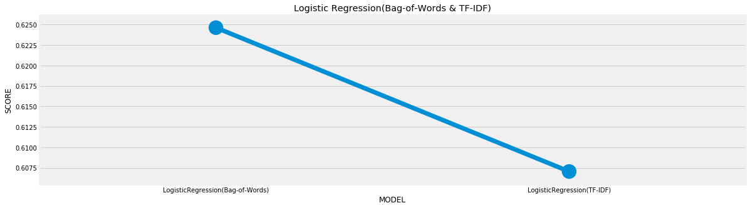

Slide 33
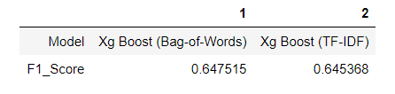


Slide 34
Final Results
We present results for sentiment analysis on Twitter. We investigated four kinds of models that is,Random Forest, Logistic Regression,Support Vector Machine and XGBoost and demonstrate that XGBoost performed well.
For our feature-based approach we used Bag Of Words, Word2Vec, Doc2Vec and TF-IDF feature.
We found that using Logistic Regression model with features Count Vectorization performed well with 0.66 f1-score.

Slide 35
Insights & Decisions
The results are interesting and warrant explanation. For those who actively review sentiment analysis around brands and keywords the vast majority of conversations contributed towards a neutral view. Tweets that contribute towards the neutral percentage are most likely to have contained the hashtag or simply a reference as part of another conversations. For example, neutral tweets include live tweeting of sessions, questions or statements regarding festival, or real-time observations and questions inside and outside SXSW.
However, SXSW fans did express their adoration and support for the event but judging from the words of those who expressed their views, we realized there are few negative sentiment and positive sentiment.

Slide 36
Next Steps
We look forward to use bigger dataset which can give enough information to improve the accuracy,considering the emoticons and internationalization. Also for better insights to find sentiment we could have used clustering(cosine similarity) only for sentiment and N gram analysis to find whether its positive,negative or neutral.

Slide 37
References
https://www.analyticsvidhya.com/blog/2018/07/hands-on-sentiment-analysis-dataset-python/
https://www.kaggle.com/tanulsingh077/twitter-sentiment-extaction-analysis-eda-and-model
https://towardsdatascience.com/social-media-sentiment-analysis-part-ii-bcacca5aaa39 , https://www.analyticsvidhya.com/blog/2018/07/hands-on-sentiment-analysis-dataset-python/
https://towardsdatascience.com/another-twitter-sentiment-analysis-bb5b01ebad9
https://www.geeksforgeeks.org/twitter-sentiment-analysis-using-python/
https://towardsdatascience.com/creating-the-twitter-sentiment-analysis-program-in-python-with-naive-bayes-classification-672e5589a7ed

Slide 38


